Slide 1


Slide 2
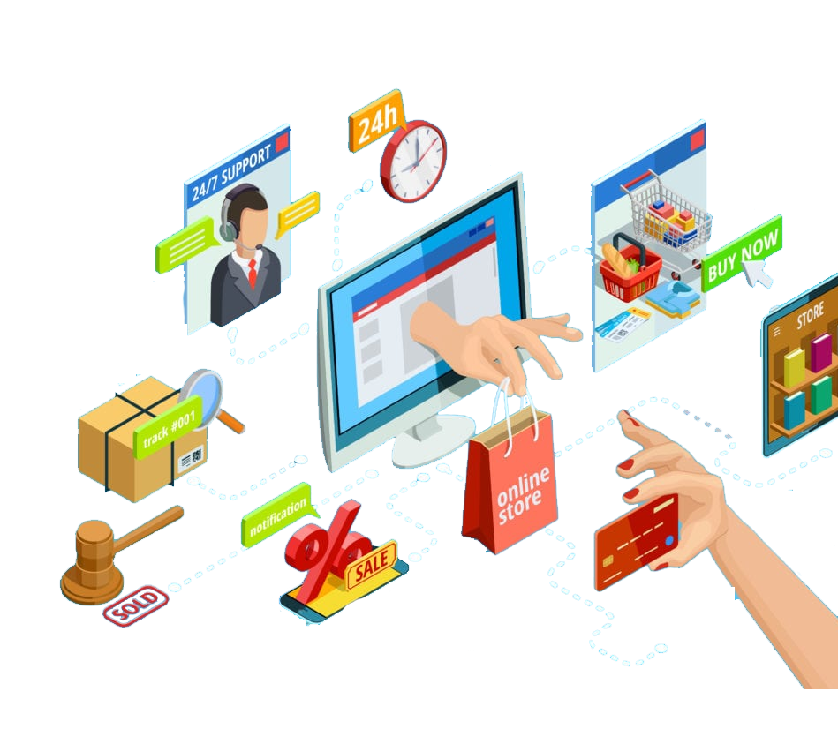
Intro to E-commerce Marketing

Slide 3
What is E-commerce Marketing?
Definition
E-commerce marketing refers to the strategies used to drive traffic to online stores and convert visitors into customers
Importance
Essential for reaching potential customers in the digital marketplace
Focuses on increasing sales, customer engagement, and brand visibility

Slide 4
Types of E-commerce
Business Models
B2C (Business to Consumer)
Direct sales from businesses to consumers (e.g., Amazon)
B2B (Business to Business)
Transactions between businesses (e.g., wholesale suppliers)
C2C (Consumer to Consumer)
Consumers selling to other consumers (e.g., eBay)
C2B (Consumer to Business)
Individuals offering products/services to businesses (e.g., freelancers)

Slide 5
Key Components of E-commerce Marketing
Website Optimization
Ensure a user-friendly, mobile-responsive site with fast load times
Search Engine Optimization (SEO)
Optimize product pages for search engines to increase visibility
Social Media Marketing
Promote products on platforms like Instagram and Facebook to engage with customers
Email Marketing
Use targeted campaigns to reach customers with personalized offers

Slide 6
Building an Online Store
Choosing a Platform
Shopify
User-friendly, ideal for beginners
WooCommerce
WordPress plugin for customization
BigCommerce
Scalable solution for growing businesses
Setting Up Your Store
Select a domain name and hosting
Design the store layout and product pages
Set up payment gateways (PayPal, Stripe)

Slide 7
Product Listing Optimization
Key Elements
High-Quality Images
Use multiple angles and lifestyle images
WooCommerce
Highlight features, benefits, and specifications
BigCommerce
Competitive pricing, discounts, and bundles
SEO for Product Listings
Use relevant keywords in titles, descriptions, and alt text

Slide 8
Marketing Strategies for E-commerce
Content Marketing
Create valuable content (blogs, videos) that attracts and educates customers
Paid Advertising
Use Google Ads and social media ads to drive traffic and sales
Influencer Marketing
Partner with influencers to reach wider audiences and enhance credibility
Retargeting
Implement retargeting ads to bring back visitors who didn’t convert

Slide 9
Customer Engagement and Retention
Building Customer Relationships
Utilize personalized email marketing and loyalty programs
Customer Service
Offer excellent support through chat, email, and phone
Feedback and Reviews
Encourage and respond to customer reviews to build trust

Slide 10
Measuring E-commerce Success
Key Metrics to Track
Conversion Rate
Percentage of visitors who make a purchase
Average Order Value (AOV)
Average amount spent per transaction
Customer Acquisition Cost (CAC)
Cost associated with acquiring a new customer
Return on Investment (ROI)
Measure the profitability of marketing efforts
Tools for Analytics
Google Analytics, e-commerce tracking, and social media insights

Slide 11
Discussion Questions
What do you think are the most important factors for a successful e-commerce business?
(Encourage participants to share their insights)
Have you ever purchased something online? What influenced your decision?
(Facilitate discussion on factors affecting online purchasing behavior)

Slide 12
Next Steps and Final Project
Final Project Overview
Think about setting up a basic online store using Shopify or HTML/CSS/JavaScript with at least 3 products listed

Slide 13


Slide 14


